Slide 1

Wireless Network
MIT-
By-
Jesmin Akhter
Associate Professor
Institute of Information Technology
Jahangirnagar University

Slide 2

Lecture 07 3G Mobile Communications 4G Mobile Communications

Slide 3
3G System
The third generation (3G) cellular networks were developed with the aim of offering high speed data and multimedia connectivity to subscribers. The International Telecommunication Union (ITU) provides the standard known as, IMT-2000 (International Mobile Telecommmunications-2000 for 3G systems.
The aim of IMT-2000 is to harmonize worldwide 3G systems to provide Global Roaming.

Slide 4
IMT-2000 Vision
Common Spectrum worldwide (1.8-2.2 GHz band)
Multiple radio environments (cellular, cordless, satellite, LANs)
Wide range of telecommunication services (voice, data, multimedia, Internet)
Global seamless roaming
Enhance security and performance
Integration of satellite and terrestrial system.

Slide 5
3G W-CDMA (UMTS)
Universal Mobile Telecommunications System (UMTS) is the generic name for 3G developed by the European Telecommunications Standards Institute (ETSI) based on the specifications of IMT-2000 developed by the International Telecommunications Union (ITU).
The technology is based on the GSM standard.
Developed and maintained by the 3GPP (3rd Generation Partnership Project ).
UMTS uses wideband code division multiple access (W-CDMA) radio access technology to offer greater spectral efficiency and bandwidth to mobile network operators.
W-CDMA uses the DS-CDMA channel access method with a pair of 5 MHz wide channels.
In telecommunications, direct-sequence spread spectrum (DSSS) is a spread spectrum modulation technique used to reduce overall signal interference. The spreading of this signal makes the resulting wideband channel for greater resistance to unintentional and intentional interference.

Slide 6
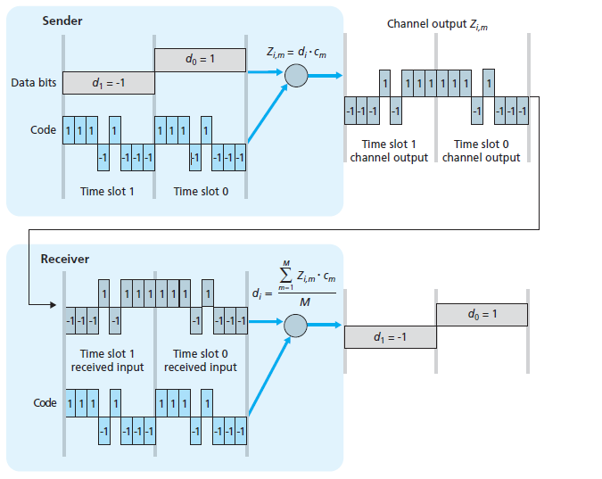
Here user-information bits are spread over a wide bandwidth (much larger than the information signal bandwidth) by multiplying the user data with the spreading code. The chip (symbol rate) rate of the spreading sequence is 3.84 Mcps, which, in the WCDMA system deployment is used together with the 5 MHz carrier spacing.
A simple CDMA example: sender encoding, receiver decoding
Notes:
Megachips per second (Mcps) is a measure of the speed with which encoding elements, are generated in Direct Sequence Spread Spectrum (DSSS) signals. This speed is also known as the chipping rate. A speed of 1 Mcps is equivalent to 1,000,000, or 10⁶, chips per second.

Slide 7
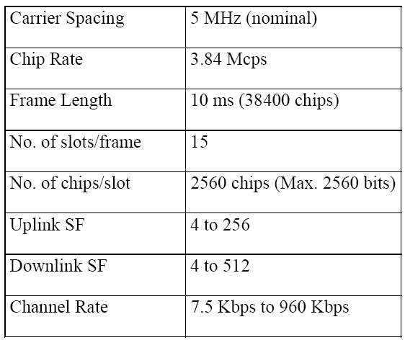
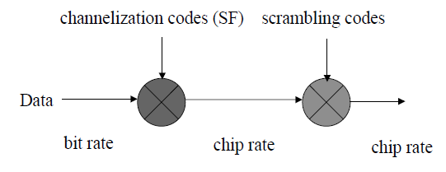
Scrambler
Used for Data Encryption. Make call more secure.
Randomizes data. Prevents the transition of a long series of 1’s or 0’s

Slide 8
UMTS
UMTS is the European vision of 3G.
UMTS is an upgrade from GSM via GPRS or EDGE.
The standardization work for UMTS is carried out by Third Generation Partnership Project (3GPP).
Data rates of UMTS are:
144 kbps for rural
384 kbps for urban outdoor
2048 kbps for indoor and low range outdoor

Slide 9
UMTS System Architecture
A UMTS network consists of three interacting domains: Core Network (CN), UMTS Terrestrial Radio Access Network (UTRAN) and User Equipment (UE) or ME.
Core Network is composed of circuit switched and packet switched functional modules.
UMTS Terrestrial Radio Access Network (UTRAN) is composed of NodeB and RNC.
The 3G system terminal is called ‘‘UE’’ and it contains two separate parts: Mobile Equipment (ME) and the UMTS Service Identity Module (USIM). USIM contains member specific data and enables the authenticated entry of the subscriber into the network.

Slide 10
This UMTS UE is capable of working in three modes: CS (circuit switched) mode, PS (packet switched) mode and CS/PS mode.
Circuit Switch
Packet Switch
Serving GPRS Support Node (SGSN)
Gateway GPRS Support Node (GGSN)
UMTS Network Architecture

Slide 11
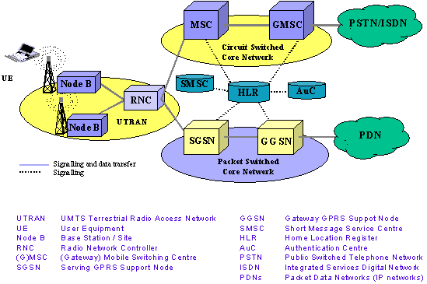
Radio Network Subsystem (RNS)

Slide 12
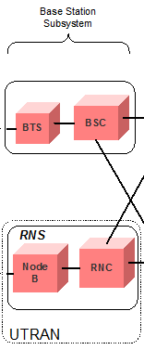
Base Station is referred as Node-B and control equipment for Node-B's is called Radio Network Controller (RNC) as if the BSC of GSM.
The functions of Node-B are:
Air interface Transmission / Reception
Modulation / Demodulation
CDMA Physical Channel coding
Micro Diversity
Error Handing
Closed loop power control
The functions of RNC are: Radio Resource Control
Admission Control
Channel Allocation
Power Control Settings
Handover Control
Macro Diversity
Ciphering
Segmentation / Reassembly
Broadcast Signaling
Open Loop Power Control

Slide 13
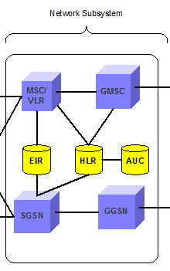
Core Network (CN) :
The Core Network is divided in circuit switched and packet switched domains.
Some of the circuit switched elements are Mobile services Switching Centre (MSC), Visitor location register (VLR) and Gateway MSC.
Packet switched elements are Serving GPRS Support Node (SGSN) and Gateway GPRS Support Node (GGSN). Some network elements, like EIR, HLR, VLR and AUC are shared by both domains.
To provide switching, routing and transit for user traffic. The basic CN architecture for UMTS is based on the GSM network with GPRS.
Notes:
General Packet Radio Services (GPRS) is a packet-based wireless communication service that promises data rates from 56 up to 114 Kbps and continuous connection to the Internet for mobile phone and computer users

Slide 14
Serving GPRS Support Node (SGSN) interfaces the access network of MS and the Gateway GPRS Support Node (GGSN) connects UMTS core network with external packet network like Internet, X.25 or similar.
The Asynchronous Transfer Mode (ATM) is defined for UMTS core transmission. The ATM Adaptation Layer type 2 (AAL2) handles the circuit switched connection and the packet connection protocol AAL5 is designed for data delivery.
Packet-switched networks move data in separate, small blocks -- packets -- based on the destination address in each packet. When received, packets are reassembled in the proper sequence to make up the message. Circuit-switched networks require dedicated point-to-point connections during calls.
Notes:
Asynchronous transfer mode (ATM) is a switching technique used by telecommunication networks that uses asynchronous time-division multiplexing to encode data into small, fixed-sized cells. This is different from Ethernet or Internet, which use variable packet sizes for data or frames.
Short for Asynchronous Transfer Mode, a network technology based on transferring data in cells or packets of a fixed size. The small, constant cell size allows ATM equipment to transmit video, audio, and computer data over the same network, and assure that no single type of data hogs the line.

Slide 15
4G Mobile Communications (WiMAX and LTE)

Slide 16
History
In March 2008, the International Telecommunications Union-Radio communications (ITU-R) specified a set of requirements for 4G standards, named the International Mobile Telecommunications Advanced (IMT-Advanced) specification, setting peak speed requirements for 4G service at 300 Mbit/s for high mobility communication (such as from trains and cars) and 1Gbit/s for low mobility communication (such as pedestrians and stationary users).
Since the first-release versions of Mobile WiMAX (first used in South Korea in 2007) and LTE (in Oslo, Norway and Stockholm, Sweden since 2009 )support much less than 1 Gbit/s peak bit rate, they are not fully IMT-Advanced compliant, but are often branded 4G by service providers.
On December 6, 2010, ITU-R recognized that these two technologies, as well as other beyond-3G technologies that do not fulfill the IMT-Advanced requirements, could nevertheless be considered "4G", provided they represent forerunners to IMT-Advanced compliant versions .

Slide 17
During the spring 2011 above two system provide their advanced version as: Mobile WiMAX Release 2 (also known as WirelessMAN-Advanced or IEEE 802.16m') and LTE Advanced (LTE-A, Based on UMTS 3G technology) and promising speeds in the order of 1 Gbit/s in 2013.

Slide 18
Comparison of 3G and 4G
3G | 4G
Data Rates of 100 Kbps to 2 Mbps Goal is 'to provide multimedia multirate mobile communications anytime and anywhere'. Connection between the cellular world and the wired Internet firmly established. Mobile devices used mainly for Human-to-Human and Human-to-Machine communication | Data Rates up to 100 Mbps Expansion on the 3G goal to provide a wider range of new and improved multimedia services. Integration of broadcast, cellular, cordless, Wireless LAN, short-range and fixed wire systems to appear as a single seamless network. Not only the 3G modes of communication but also characterized by a great deal of Machine-to-Machine traffic

Slide 19
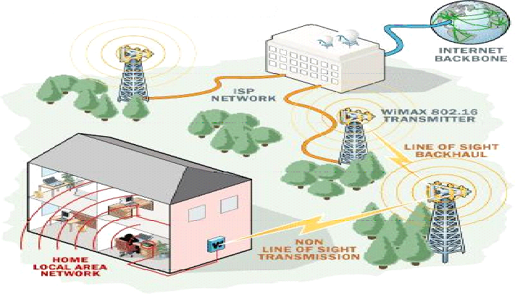
WiMAX
Wi-MAX : The Worldwide Interoperability for Microwave Access, is a technology aimed at providing wireless data over long distances It is based on the IEEE 802.16 standard.
Fig.1

Slide 20
Some important features of WiMAX are given below:
OFDM in physical layer: The access technique used in physical layer of WiMAX is OFDM; where the high speed serial data is converted to low rate parallel streams and each stream is modulated by separate carrier each one is known as subcarrier. Subcarriers are mutually orthogonal and deals with low data rate hence can protect multipath fading.
Very high peak data rates: The data rate of WiMAX is 70Mbps under the channel of bandwidth of 20 MHz. The rate can be further increased using space division multiplexing i.e. incorporation of multiple antennas.

Slide 21
Adaptive Modulation and Coding: The IEEE 802.16e standard changes modulation and channel coding scheme based on received SNR. For example a SS close to the BS can use a high modulation scheme (more bits per symbol) i.e. the system can get more capacity but when the SS is at the cell boarder the system permits lower modulation scheme (increased signal space on orthogonal basis function coordinate system) to avoid huge symbol error rate. Therefore the system can overcome the time selective fading (the channel condition is better at some instant than other).
Error Correction Techniques: WiMAX incorporates two types of strong error correction techniques: FEC (Forward Error Correction) for multimedia traffic and ARQ (Automatic Repeat Request) for data traffic to improve throughput.

Slide 22
Support for TDD and FDD: Like mobile cellular communication it supports both FDD (Frequency division duplexing) and TDD (Time division duplexing), as well as a half-duplex FDD.
Above features provide the flexibility of using same or different carriers for up and down link.

Slide 23
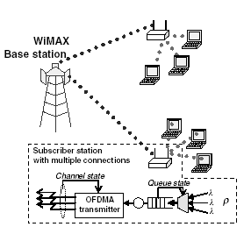
OFDMA Based WiMAX Network
We consider a single cell in a WiMAX network with a base station and multiple subscriber stations (Fig.2). Each subscriber station serves multiple connections. Admission control is used at each subscriber station to limit the number of ongoing connections through that subscriber station. At each subscriber station, traffic from all users for uplink connections are aggregated into a single queue.

Slide 24

Fig.2 System model
The size of this queue is finite (i.e., X packets) in which some packets will be dropped if the queue is full upon their arrivals. The OFDMA transmitter at the subscriber station receives packets and transmits them to the base station. The base station may allocate different number of subchannels to different subscriber stations. For example, a subscriber station with higher priority could be allocated more number of subchannels.

Slide 25
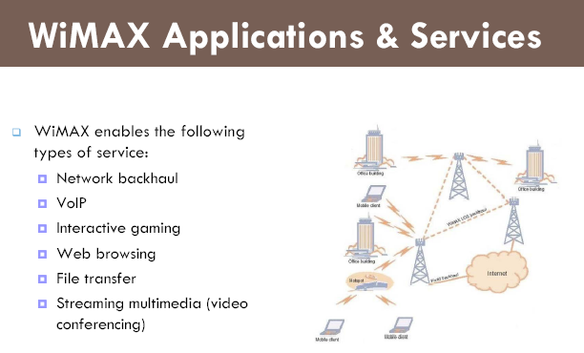
In a hierarchical telecommunications network the backhaul portion of the network comprises the intermediate links between the core network or backbone, of the network and the small sub-networks at the "edge" of the entire hierarchical network.

Slide 26
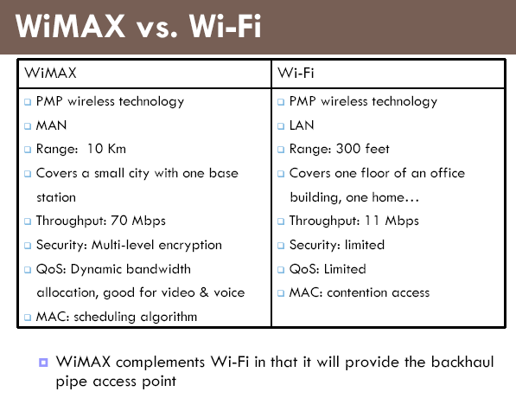

Slide 27
Long Term Evolution (LTE)
Long-term evolution (LTE) standard is one of the newly developed fourth generation (4G) standards for mobile communications. In the standard, either frequency division duplexing (FDD) or time division duplexing (TDD) schemes can be used to achieve two-way communications.

Slide 28
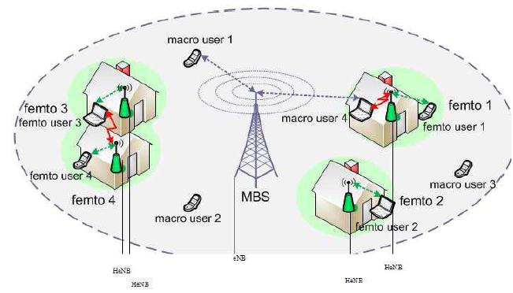
Features of LTE
The LTE- Advanced (Long Term Evolution- Advanced) is 4G wireless service proposed by 3GPP (Third generation Partnership Project). In 2009 4G LTE started its commercial service in Scandinavia. Three important features of LTE are: femtocell deployment , OFDMA-based physical layer access and MIMO.
The FBS (Femto BS) is named as Home evolved Node-B (HeNB) in LTE-A placed in public places to provide higher data rate and improve resource usage to a number of users. Femtocells are different in the sense that they are installed by customers in an ad hoc fashion without any RF planning. Objective of eNodeB Femtocells lies in off-loading of traffic.

Slide 29
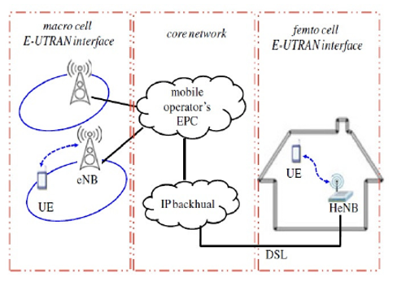
Two-tier macro-femto network architecture

Slide 30
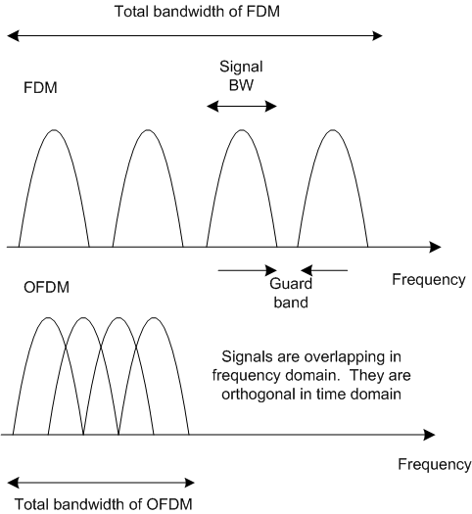
LTE provides OFDMA-based physical layer access where:
OFDMA minimizes separation between carriers
Carriers are selected so that they are orthogonal over symbol interval
Carrier orthogonality leads to frequency domain spacing ∆f =1/T, where T is the symbol time
In LTE carrier spacing is 15KHz and useful part of the symbol is 66.7 microsec.

Slide 31
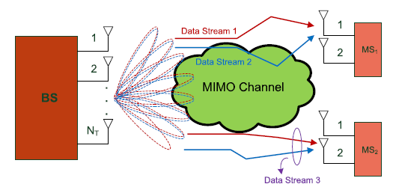
MIMO communication takes place between eNB and UE. LTE standard requires support for:
eNodeB can have maximum 4 antennas
UE can have maximum 2 antennas

Slide 32
Architecture of LTE

Slide 33
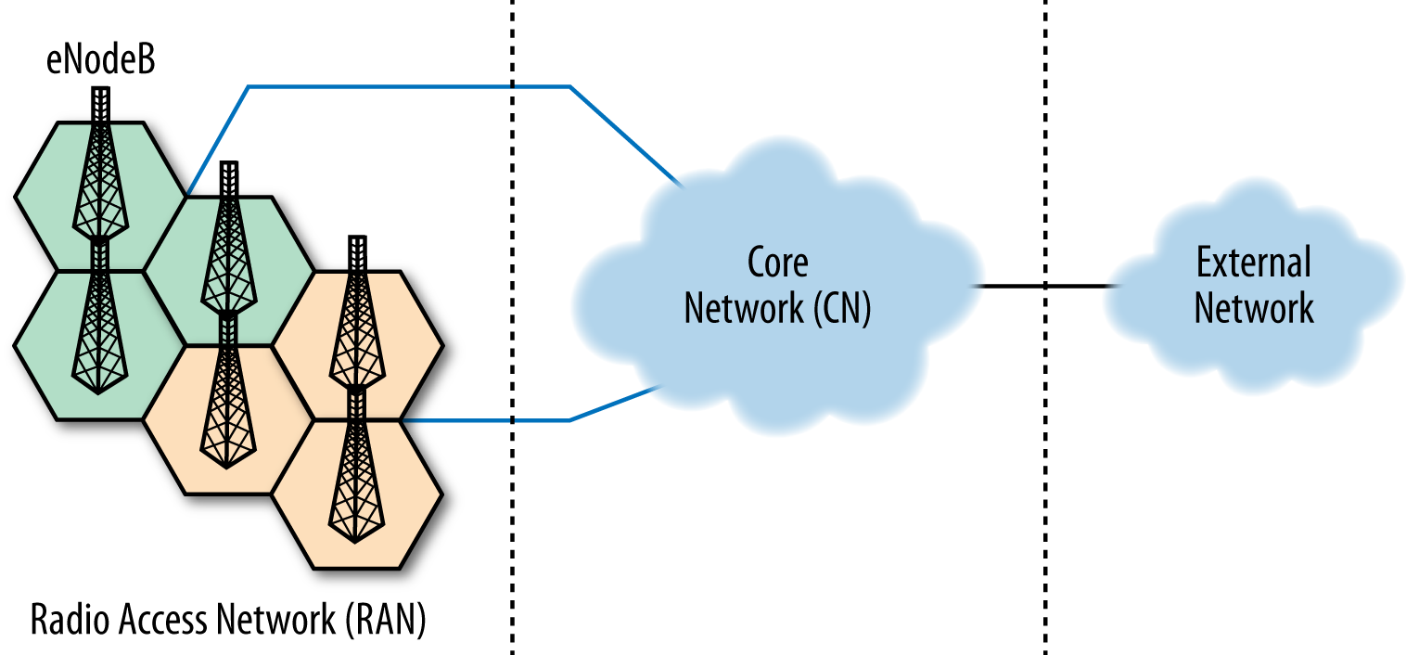
The architecture of LTE consists of two major parts: the E-UTRAN (Evolved Universal Terrestrial Radio Access Network) and the EPC (Evolved Packet Core). The first part provides air interface between MS or UE to BS and the second part is interconnected switching network called backbone or core network.

Slide 34
User Equipment (UE)
As the name suggests, a UE is the actual device that the LTE customers use to connect to the LTE network and establish their connectivity. The UE may take several forms; it can be a mobile phone, a tablet, or a data card used by a computer/notebook.
Similar to all other 3GPP systems, the UE consists of two main entities: a SIM-card or what is also known as User Service Identity Module (USIM), and the actual equipment known as Terminal Equipment (TE).
SIM-card carries the necessary information provided by the operator for user identification and authentication procedures. The terminal equipment on the other hand provides the users with the necessary hardware (e.g., processing, storage, operating system) to run their applications and utilize the LTE system services.

Slide 35
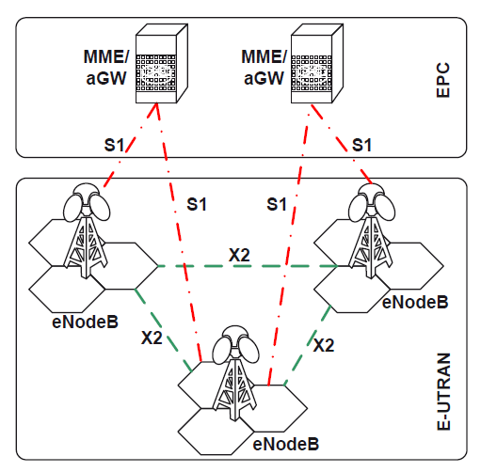
Evolved UTRAN (E-UTRAN)
The E-UTRAN in LTE consists of directly interconnected eNodeBs which are connected to each other through the X2 interface and to the core network through the S1 interface.
This eliminates one of the biggest drawbacks of the former 3GPP systems (UMTS): the need to connect and control the NodeBs through the Radio Network Controller (RNC), which make the system vulnerable to RNC failures.
The LTE E-UTRAN architecture can be seen in Figure below.

Slide 36
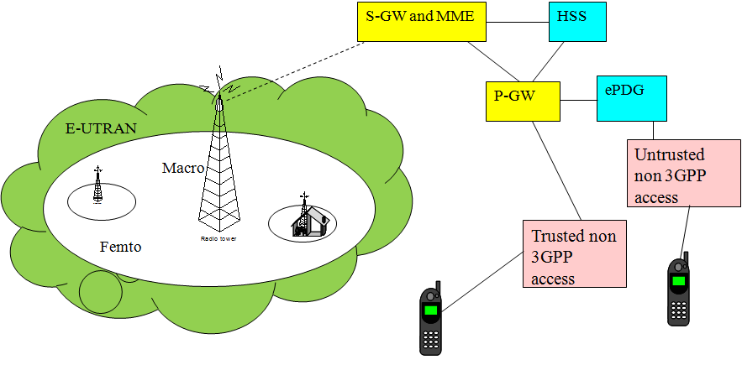
Evolved Packet Core (EPC)
The EPC (also known as the LTE core network) consists of three main entities: Mobility Management Entity (MME), Serving Gateway (S-GW) and the Packet Data Network Gateway (PDN-GW). In addition, there are some other logical entities like the Home Subscriber Server (HSS) and Policy and Charging Rules Function (PCRF).
The EPC consists of six nodes:
Home Subscriber Server (HSS) is like the combination of HLR and AUC of UMTS or GSM . It is a central database that contains information about all the network operator's subscribers.
Fig.1 Architecture of LTE

Slide 37
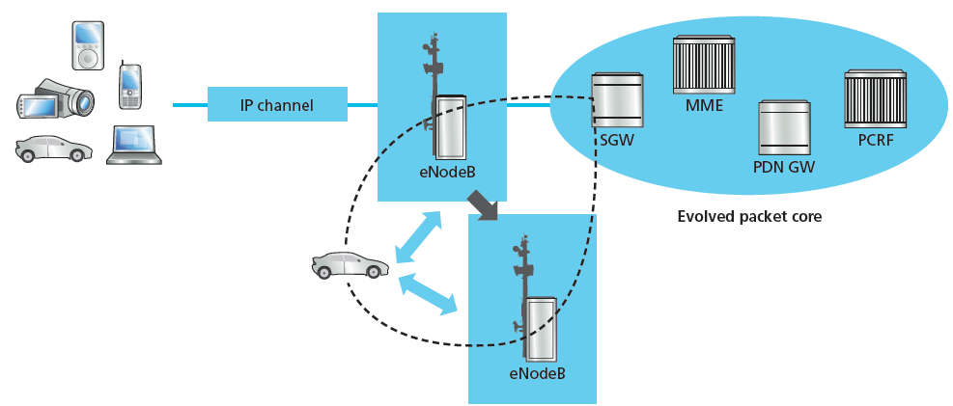
The serving gateway (S-GW)
The SGW is the termination point of the packet data network interface towards E-UTRAN. When terminals move across areas served by eNodeB elements in E-UTRAN, the SGW serves as a local mobility anchor. This means that packets are routed through this point for intra E-UTRAN mobility and mobility with other 3GPP technologies, such as 2G/GSM and 3G/UMTS. It acts as a router, and forwards data between the base station and the PDN gateway.

Slide 38
Packet Data Network Gateway
Like the SGW, the Packet Data Network Gateway (PDN GW) is the termination point of the packet data interface towards the Packet Data Network(s). As an anchor point for sessions towards the external Packet Data Networks. It communicates with the outside world.
Fig.1 Architecture of LTE

Slide 39
The MME (for Mobility Management Entity) deals with the high-level operation of the mobile by means of signalling messages and Home Subscriber Server (HSS) related to mobility of users, paging of UE in idle-mode, the assignment of network resources, and security for E-UTRAN access.

Slide 40
The Policy Control and Charging Rules Function (PCRF): This module works like: Packet filtering and billing on flow basis. It is responsible for policy control decision-making, as well as for controlling the flow-based charging functionalities in the Policy Control Enforcement Function (PCEF), which resides in the P-GW.
ePDG (Evolved Packet Data Gateway) provides secured data transmission between UE to un-trusted non-3GPP access through EPC.
Fig.1 Architecture of LTE

Slide 41
Thank You

